Slide 1
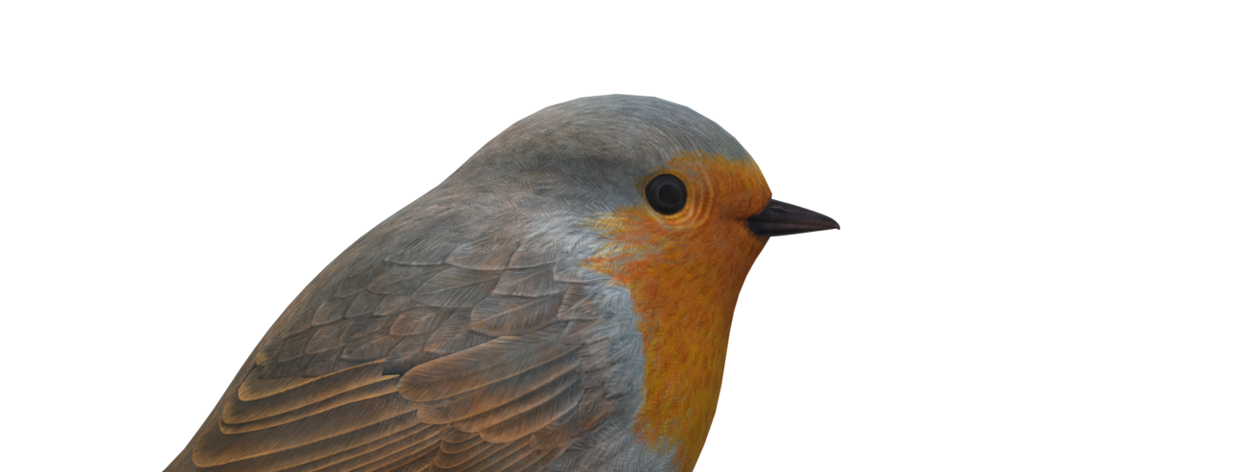
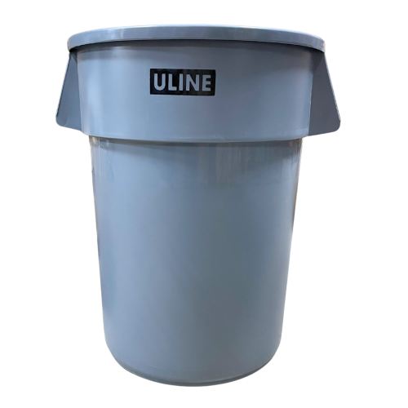

Ro-Bin
Teddy Lin and Alejandro Miranda

Slide 2
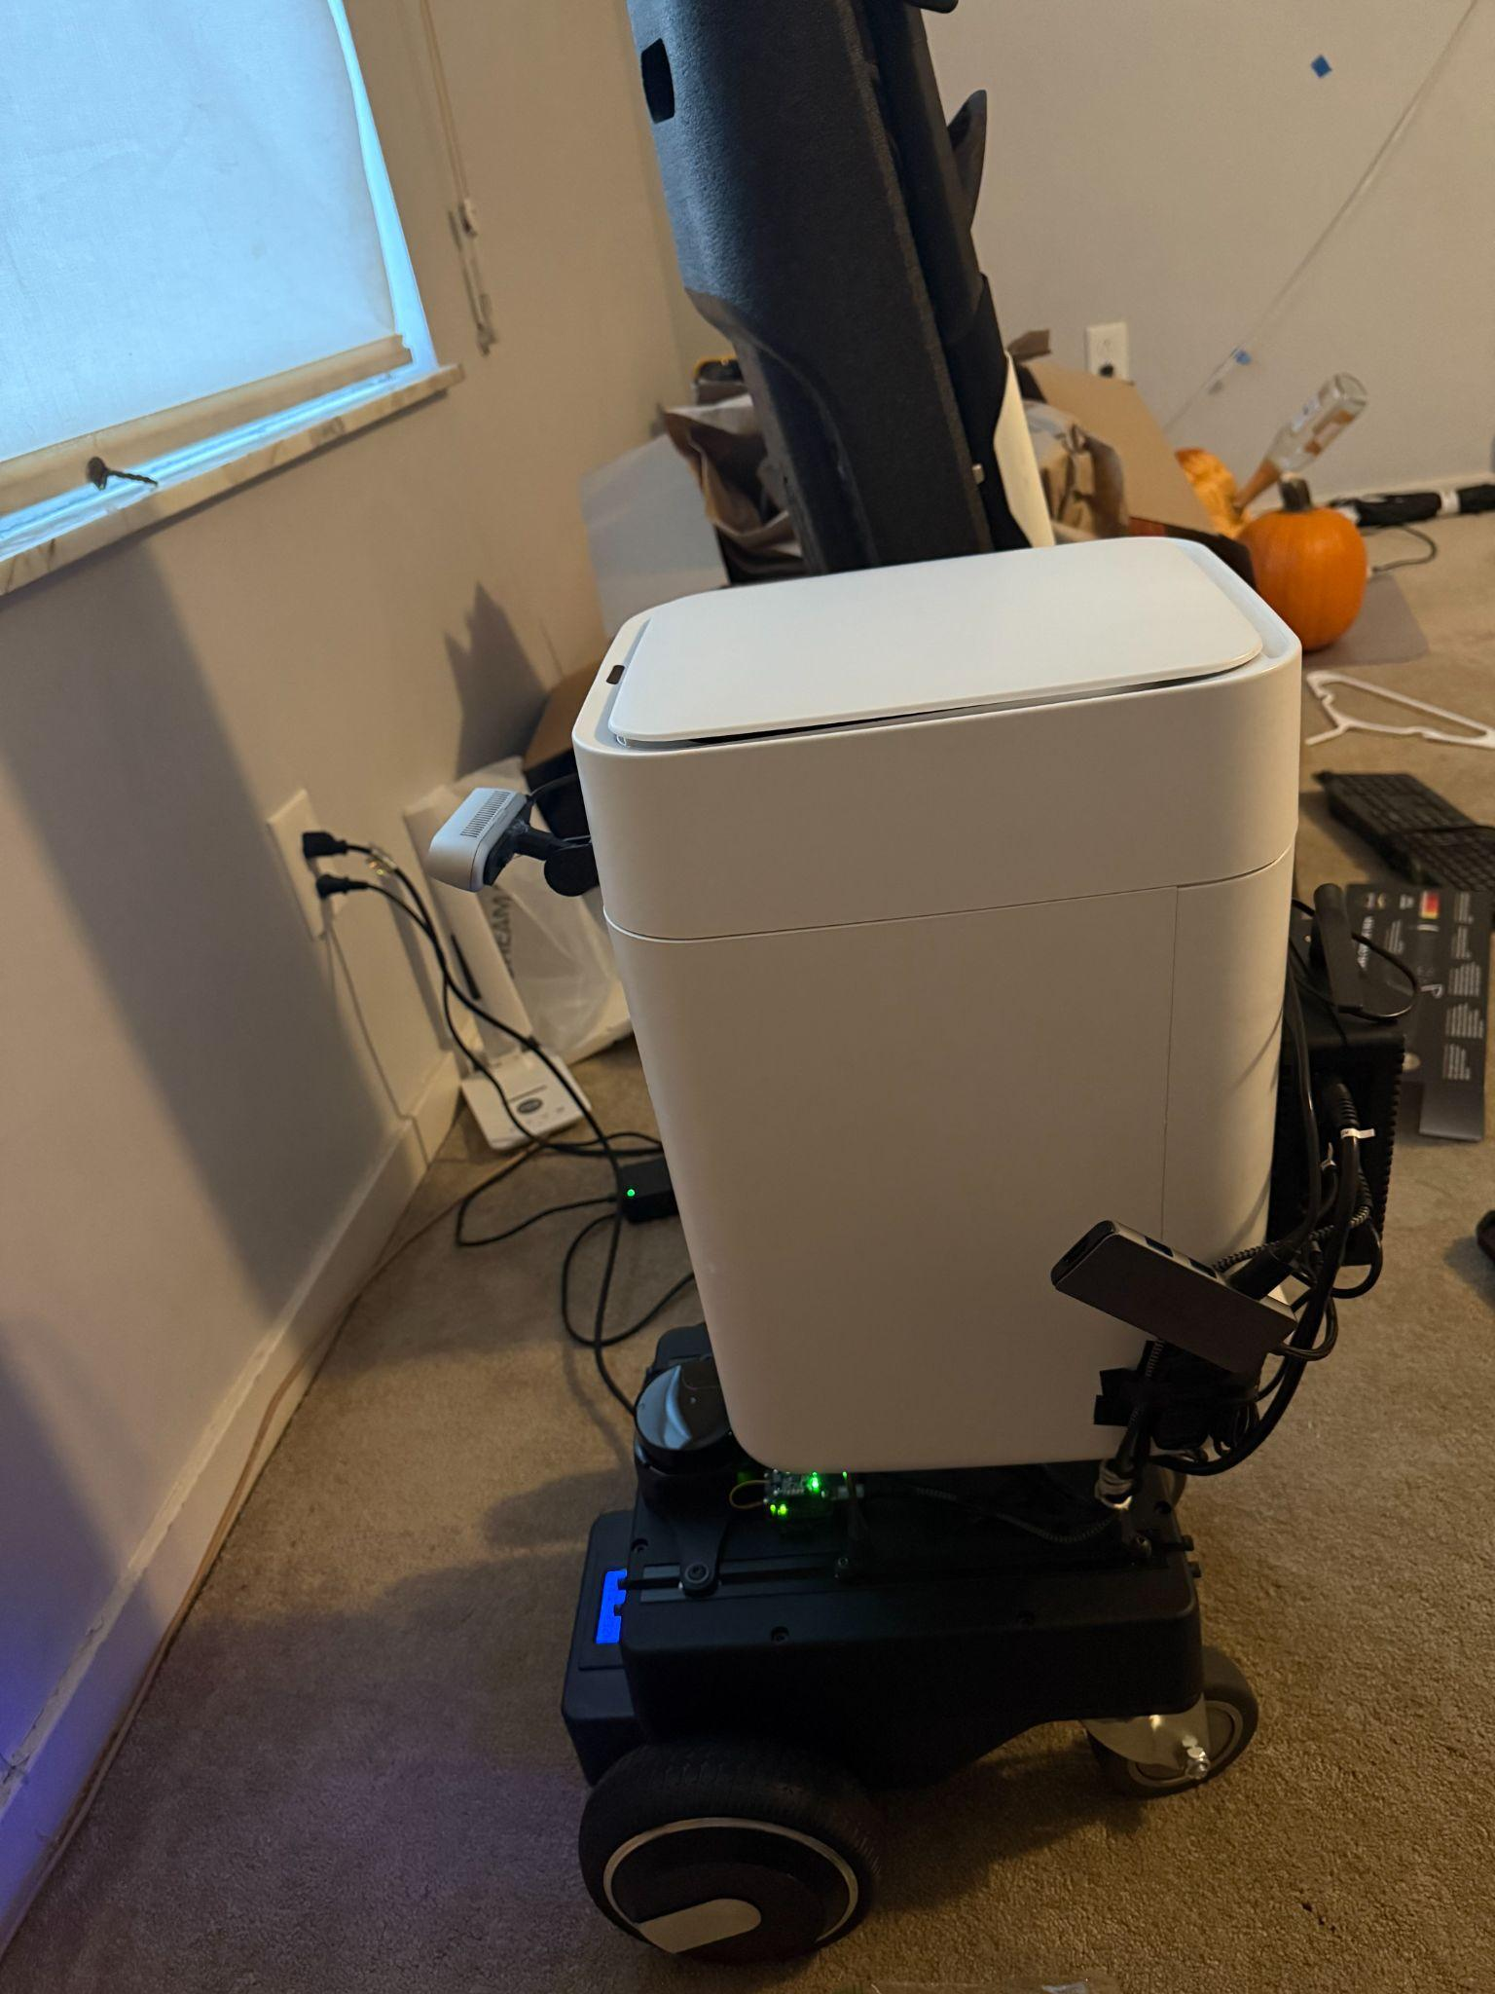
Abstract & Goals
Address overfilled and insufficient trash receptacles
Robot should autonomously approach humans for waste disposal
Interaction with robot should be natural and intuitive
System should aim to improve cleanliness in high-traffic areas

Slide 3
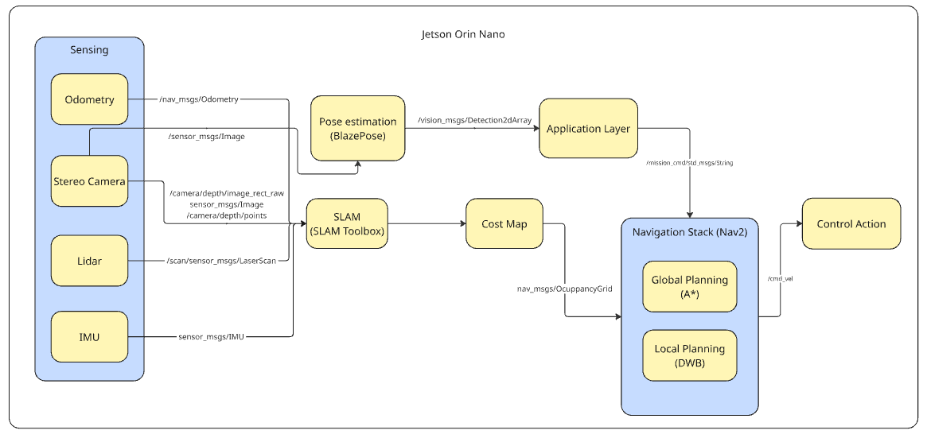
System Diagram

Slide 4
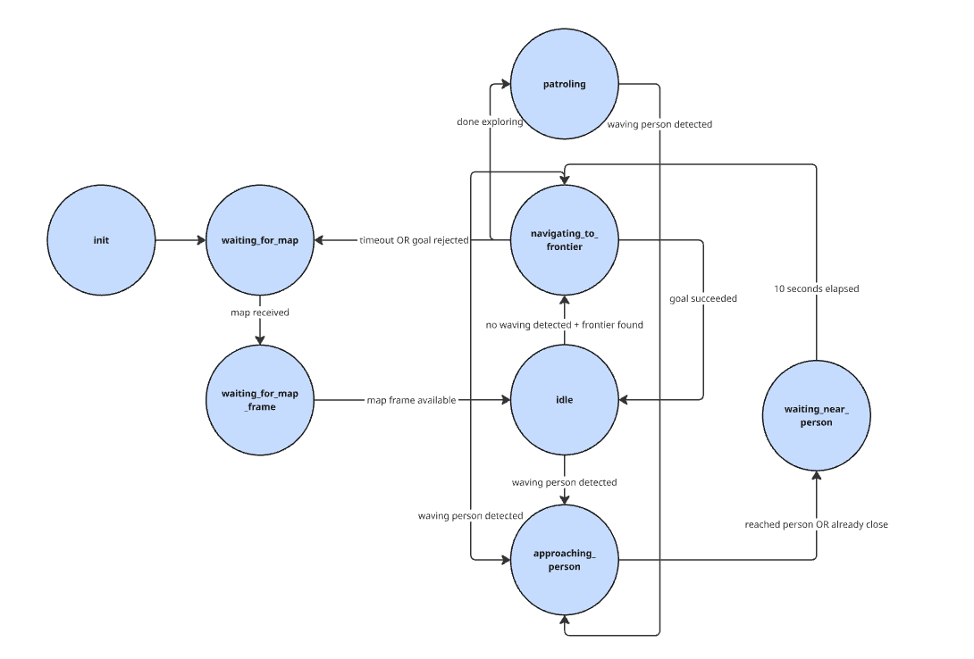
State Machine

Slide 5

Frontier Exploration/Navigation
Looks for areas where “drivable” cells are adjacent to “unknown”
Groups these cells into clusters and scores each using a weighted sum of factors:
Cluster size
Goal clearance
Path length/reachability
Path clearance
Time away from area
Uses A* for global path w/ DWB as the local controller

Slide 6
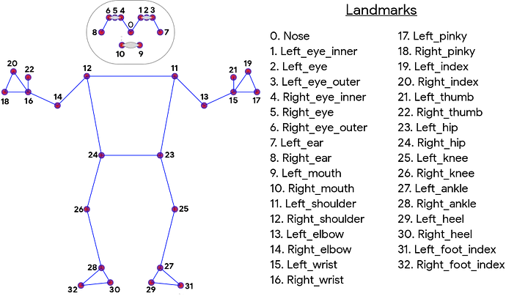
Pose Estimation with BlazePose
Benefits:
  Sufficient Accuracy
  Lightweight
  Compatible with Jetson/Jetpack 6.2
Reference: Bazarevsky, V., Grishchenko, I., Raveendran, K., Zhu, T., Zhang, F., & Grundmann, M. (2020). BlazePose: On-device Real-time Body
Pose tracking. arXiv. https://doi.org/10.48550/arXiv.2006.10204

Slide 7
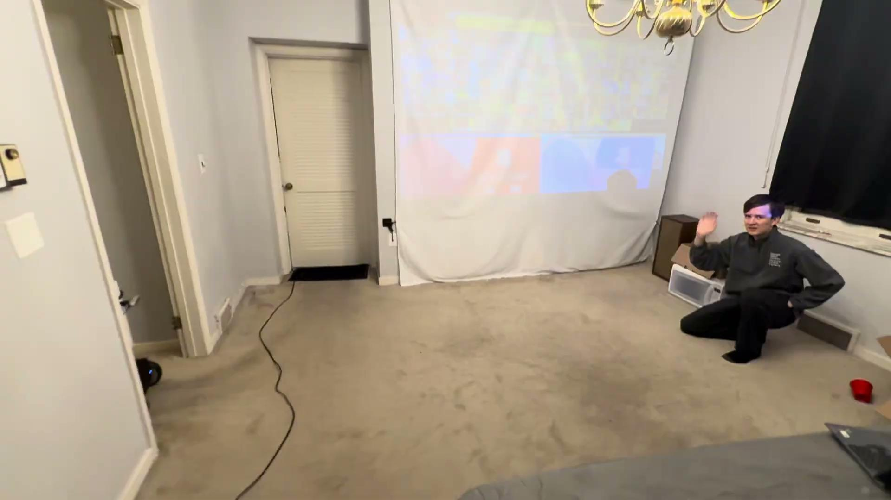
Approaching Person Demo

Slide 8

Rviz2 Visualization

Slide 9
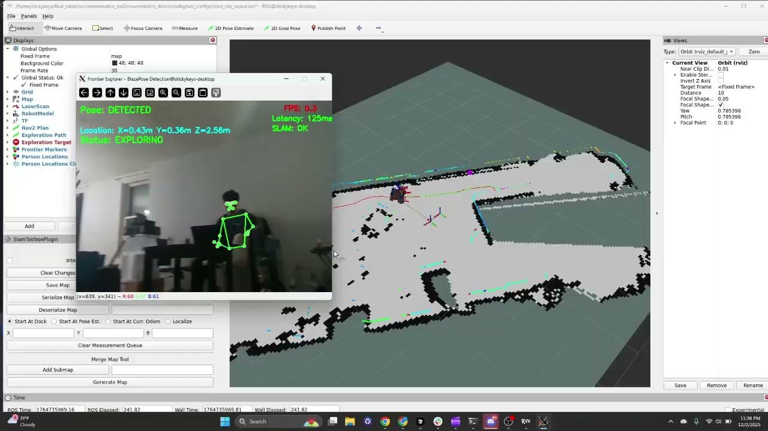
Waving Demo

Slide 10
Future Directions
AprilTag Support for Docking
Trash Bag Unloading System
Work with Other RoBin Robots in Sync

